Slide 1
College Student Safety

Slide 2
#textingfails

Slide 3
In All Assaults teens ages 12 to 17 are 176% more likely to be assaulted than adults

Slide 4
Abductions
Teenage Girls are at the highest rate of Risk for Abduction !
75% of all abductions are Females 12-17 World Wide

Slide 5
Categories for Abductions
Stranger Abductions
Non-Family Acquaintances
Stats STILL 75% of all Cases

Slide 6
Situational Awareness

Slide 7
Danger Zones
Parking Lots
Athletic Events
Dorms
Bars and Restaurants
Shopping Centers
Jogging Trails and Recreational Parks

Slide 8
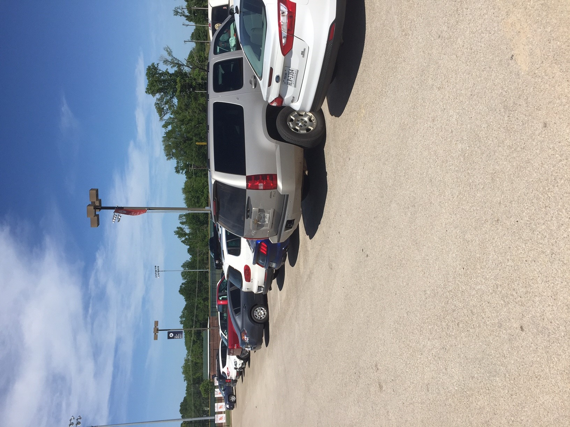
STATS
Dept of Justice
Crimes against Children Center

Slide 12
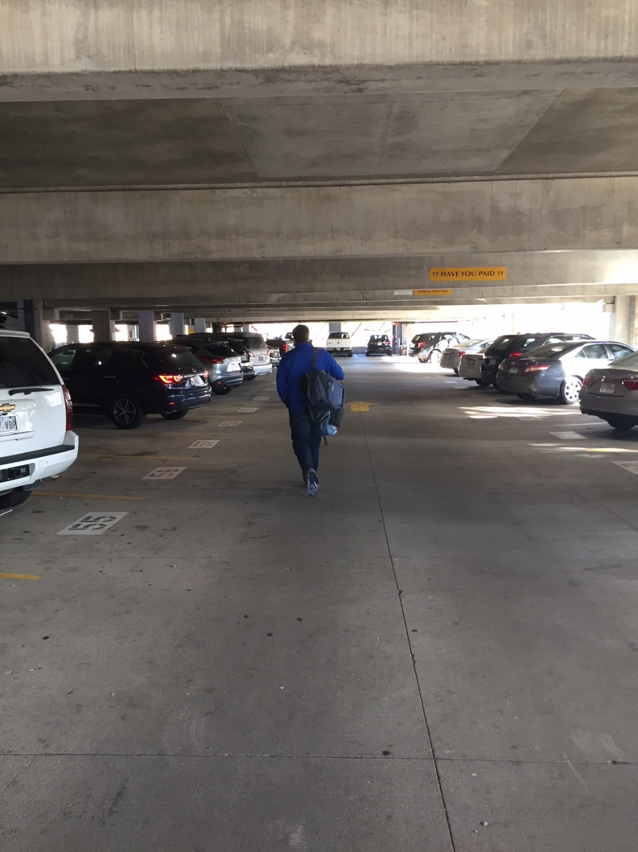

Slide 13
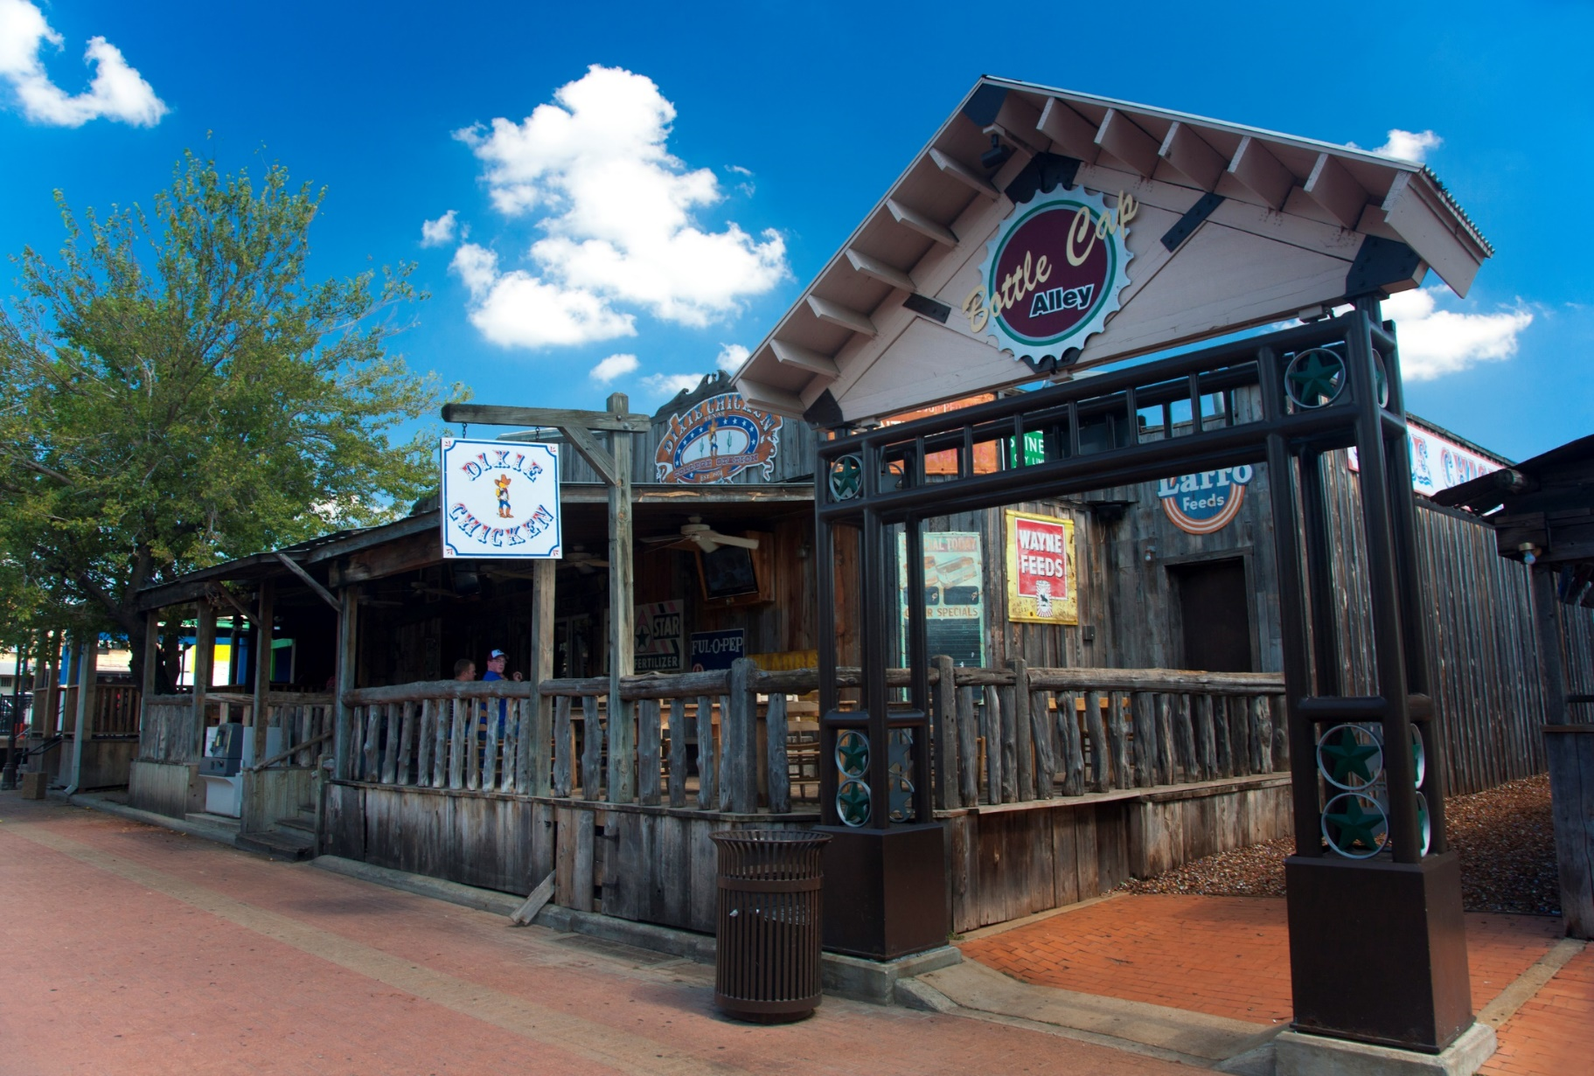
Do not take a beverage from a stranger
Be aware of where you park-try to park close to a streetlight

Slide 14
Do not leave your beverage unattended
Rohypnol- Date/Rape Drug (odorless, colorless, tasteless tablet
Causes loss of muscle control, forgetfulness, low blood pressure, dizziness, confusion, and numbness

Slide 15
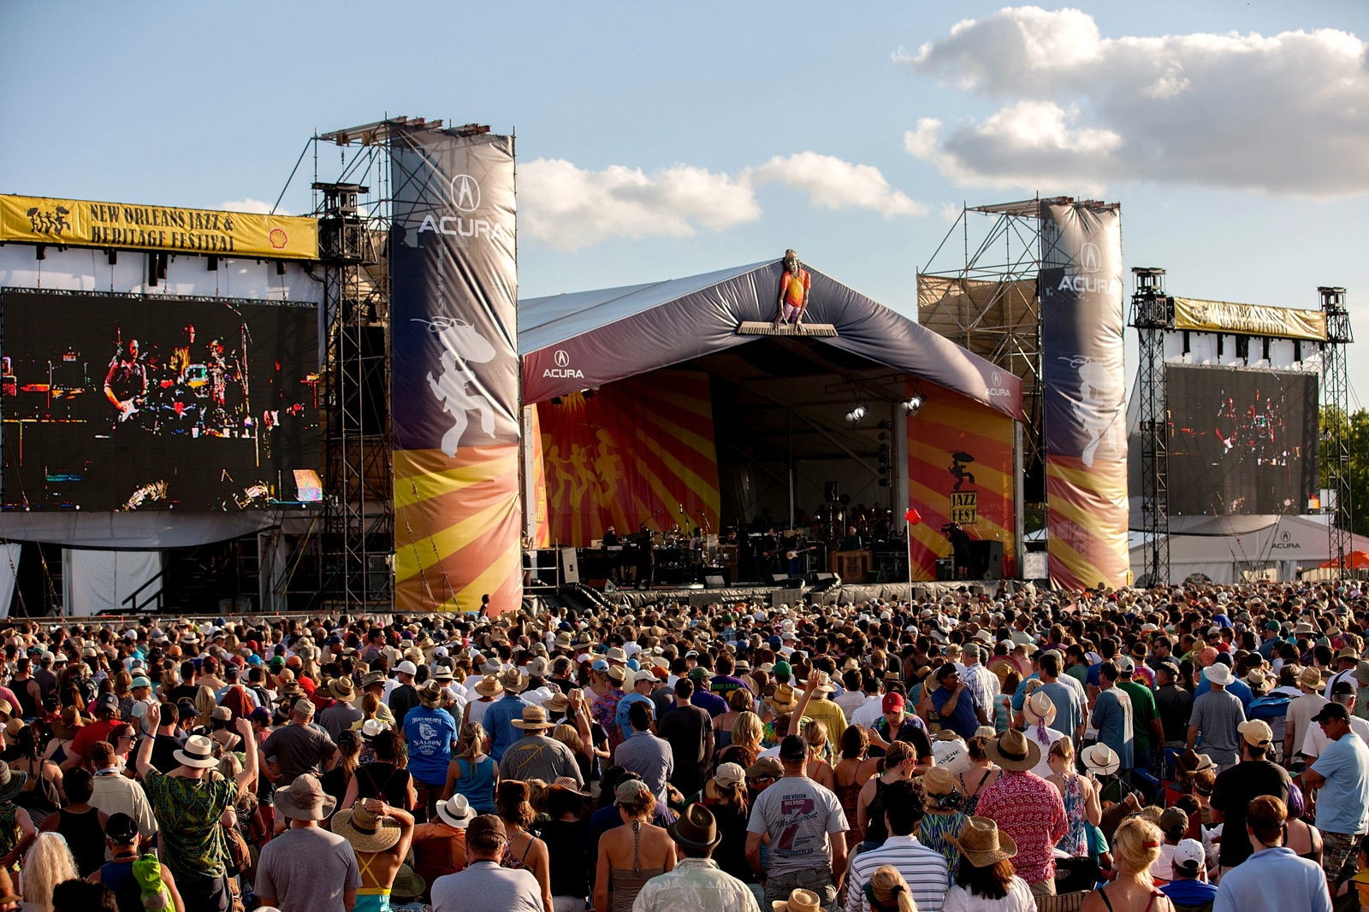
Natalie Hollaway Case

Slide 16
Danger Zone- drug into an alley
Do not go to the bathroom alone- always stay with a group
Do not let someone you don’t know walk you to your car

Slide 17
If You Find Yourself in Trouble or Compromised
Find a safe place
Lighted
With people
Get on your cell phone to find your party
Determine/know your location
Example- a business, known landmark

Slide 18
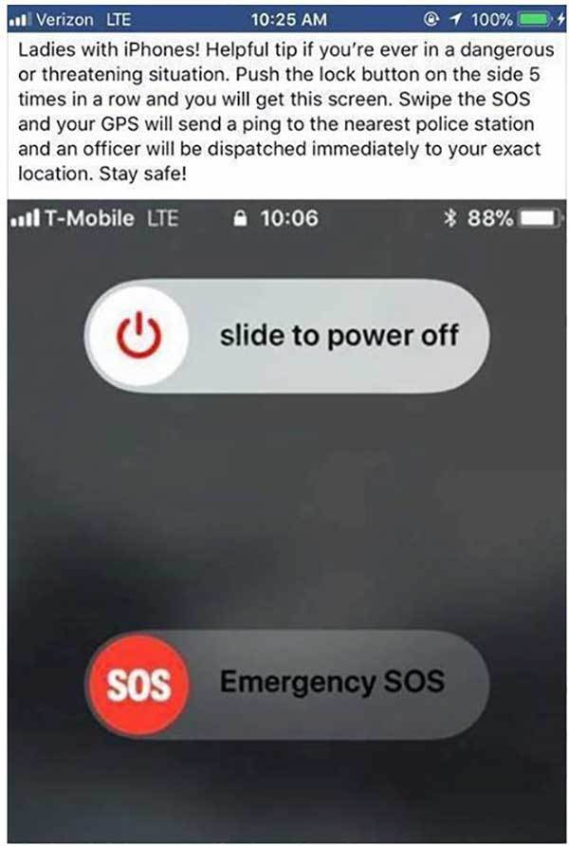
Emergency Cell Phone Setting

Slide 19
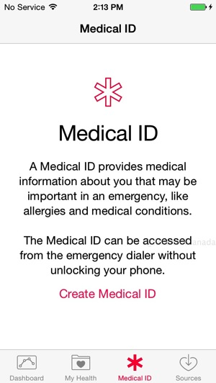
Go to your health app and select at the bottom the Medical ID
Here, you can enter important medical information and emergency contacts

Slide 20
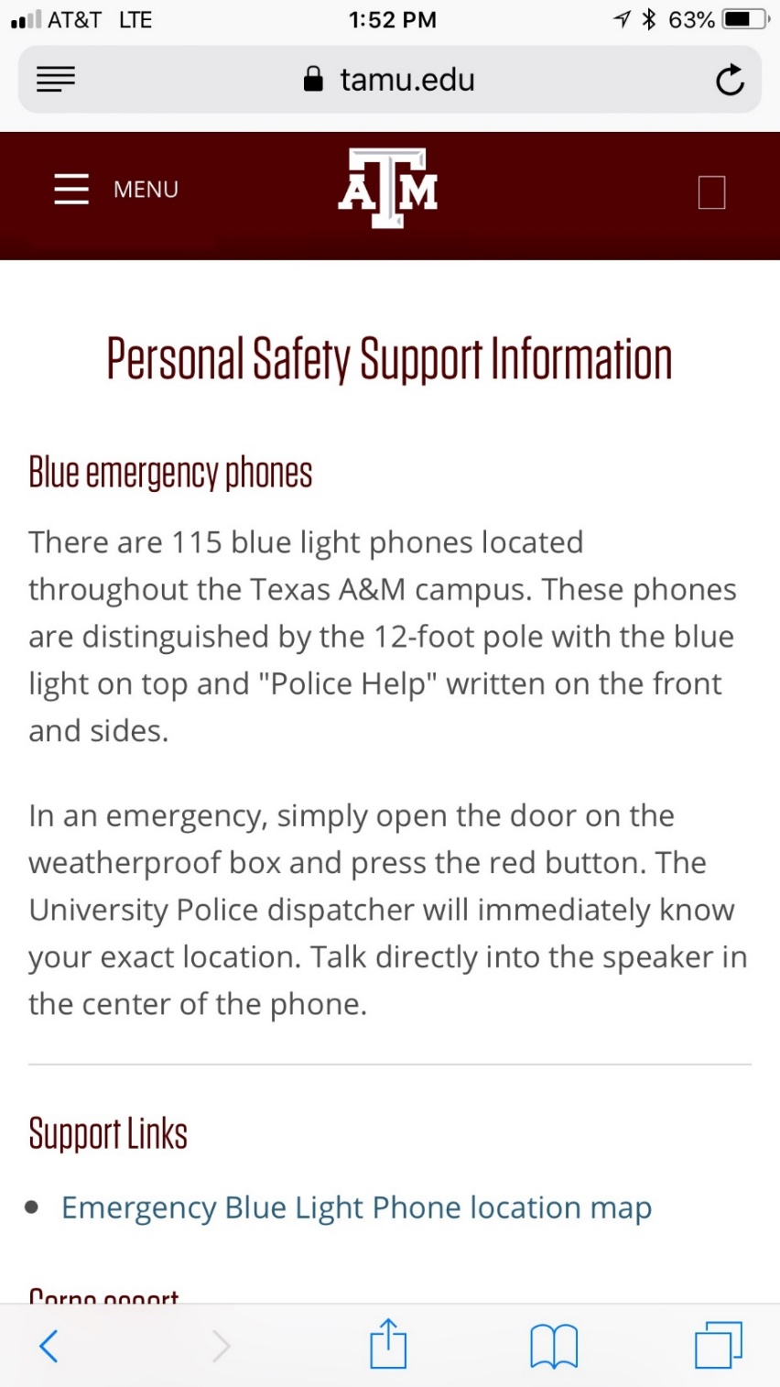
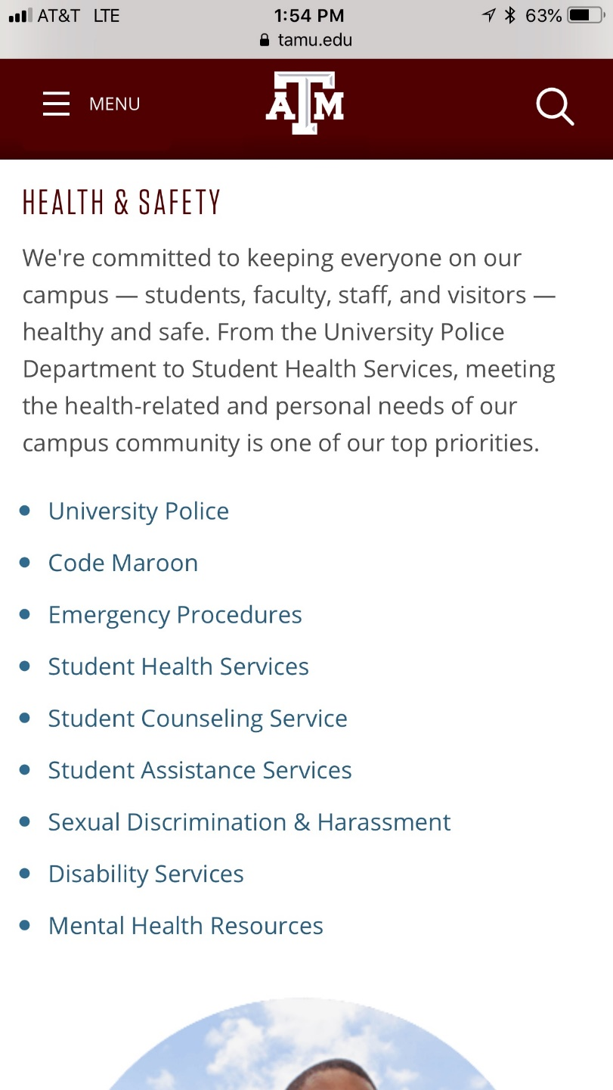

Slide 21
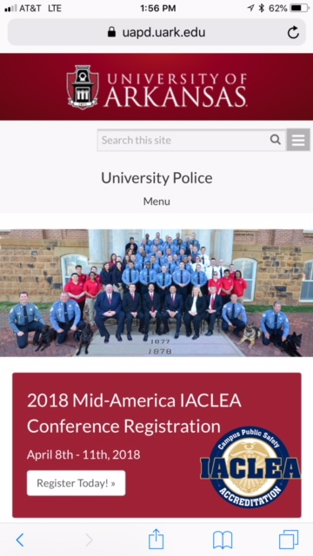

Slide 22
Alternative Actions
If you get in a situation that is bad…
Run
Resist
Fight
Invest in personal defense classes. Many universities offer these and you may be able to receive credit for them
Invest in non-lethal deterrents such as pepper spray

