Slide 1
Notetaking 101
Why and how you should take notes

Slide 2
The statistics on forgetting
Without review, 47% of what a person has just learned is forgotten in the first twenty minutes and 62% is forgotten after the first day
After 1 Day- 62% forgotten
After 2 Days- 69% forgotten
After 75 Days-75% forgotten

Slide 3
Reasons we forget
We have not learned the material well
Disuse
Interference- emotional, anxieties, distractions
Changed cues
Lack of attention and effort

Slide 4
Bad listening habits
Calling the subject dull
Listening only for facts
Criticizing the speaker
Faking attention
Tolerating distraction
Trying to write down everything

Slide 5
Ways to aid your memory
Be flexible- try new learning styles
Make a list
Schedule
Avoid Distractions
Review

Slide 6
The best strategy for remembering
NOTETAKING

Slide 7
Practical notetaking tips
If the teacher writes it down, you write it down
Use a three-ring binder with notebook paper
Do not rely on someone else’s notes- you may not understand
Date your notes- add titles and subtitles
Write legibly
Compare notes with a classmate to make sure you didn’t miss anything

Slide 8
Notetaking
Bring and use highlighters
  Look for verbal cues like, “this is important” or “make sure you understand this”
Develop a notetaking method that works for you
  Write on one side of the paper only
  Number and date each page
  Leave blank spaces
  Develop a system of shorthand- abbreviations and symbols
  Never use a sentence when you can use a phrase and never use a phrase when you can use a word

Slide 9
HOW TO take notes
Details at the top of your paper
Use the Cornell Method
Use different colors
Listen for important transition words
Use your own language
Write by hand
Review

Slide 10
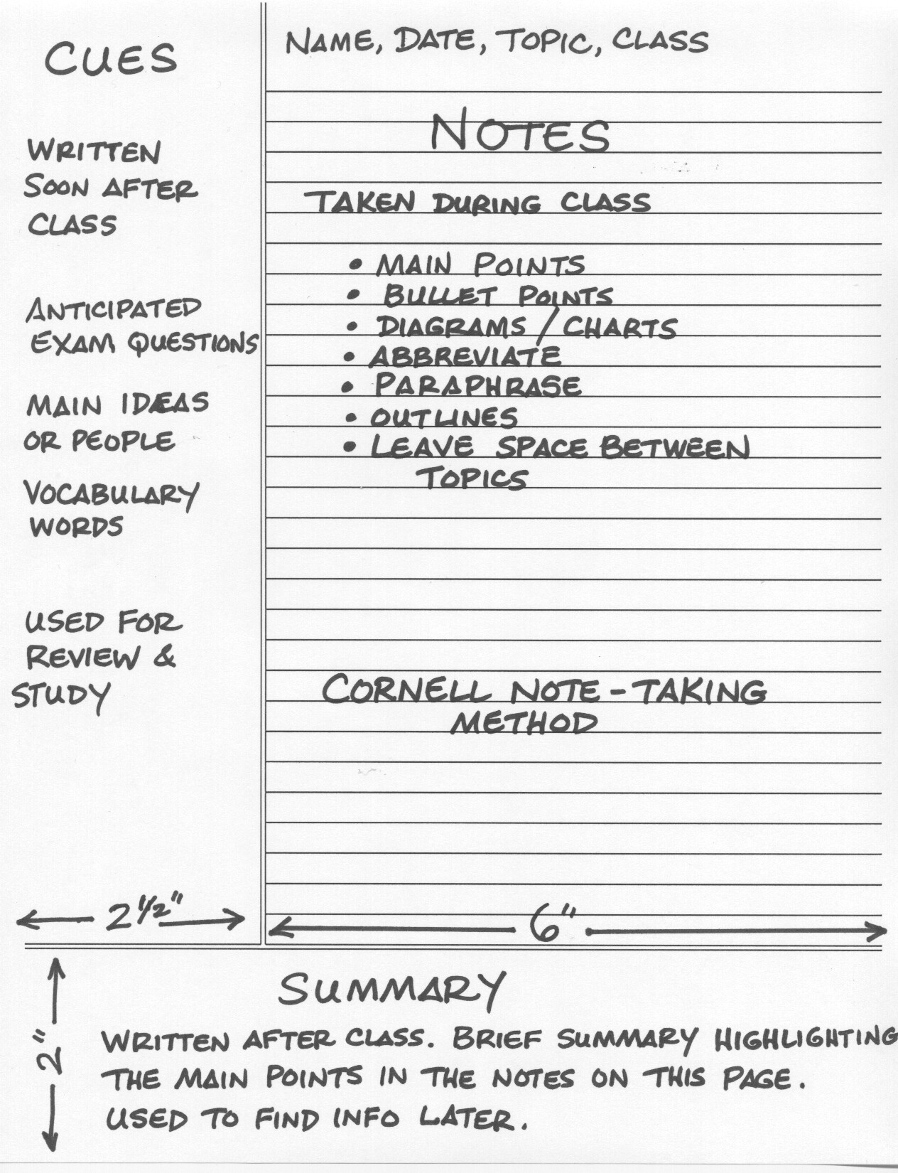
Cornell notetaking

Slide 11
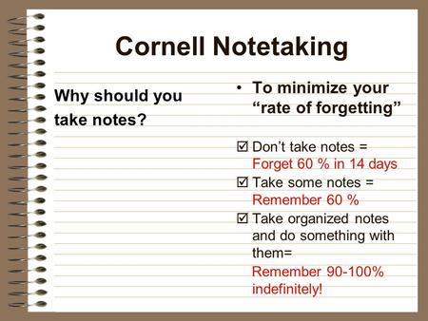

Slide 12
T-METHOD
Your Summary
Summary
Questions

Slide 13
QUESTIONS?

